Slide 1
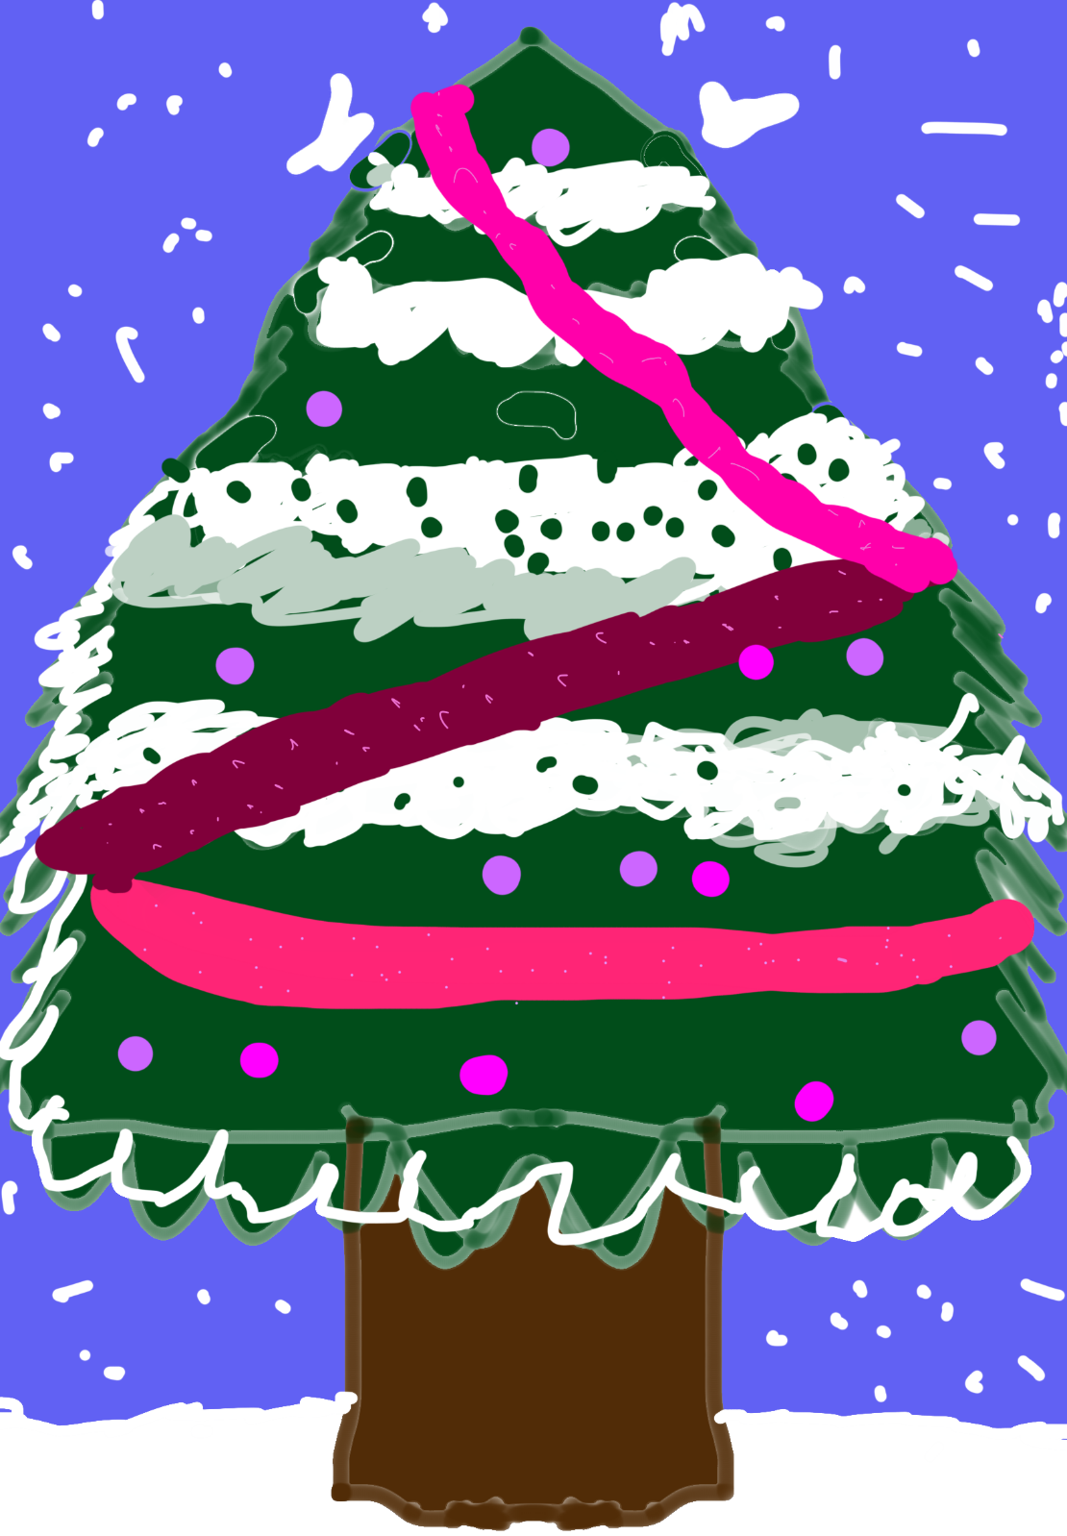
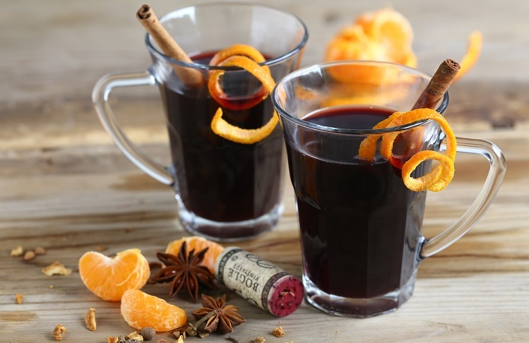
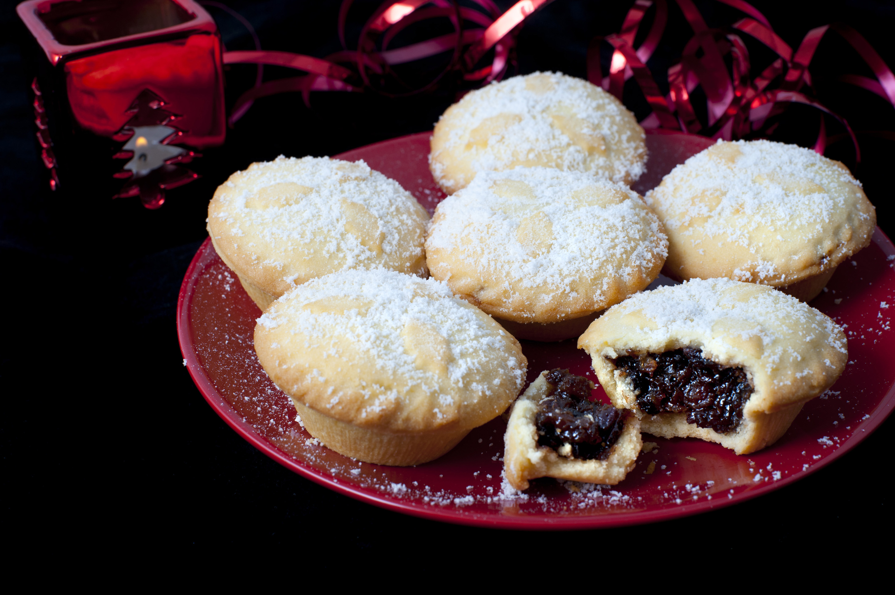
Family Christmas tree decorating
2:00pm
30th November 2024
St Edith’s Church, Grimoldby
We need you to come and help decorate our Christmas Tree.
We will provide lots of delicious treats to give you the energy needed and plenty of Mulled wine for the adults! Not to mention Christmas songs and carols to get you in the Spirit!
This Photo by Unknown Author is licensed under CC BY

